Slide 1
Snow White et la Magic Frog
Jobs/Métiers
Your dream job

Slide 2
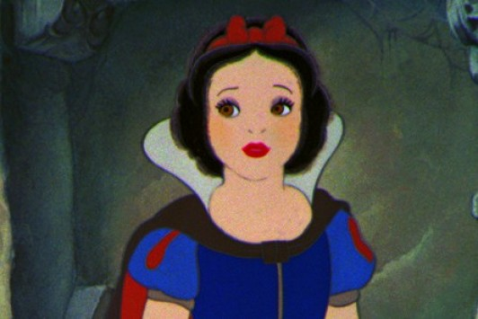
Snow White
What is her job at the end of the story? Is Snow White…
a) a vet?
b) a teacher?
c) a cook?

Slide 3
Congratulations !
That is right.
Snow White is a vet at the end of the story.

Slide 4
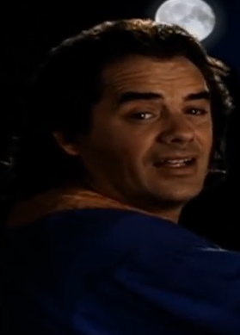
The Father
What is Snow White’s father’s job in the story?
Snow White’s father is…
a) a singer
b) a fireman
c) a pilot

Slide 5
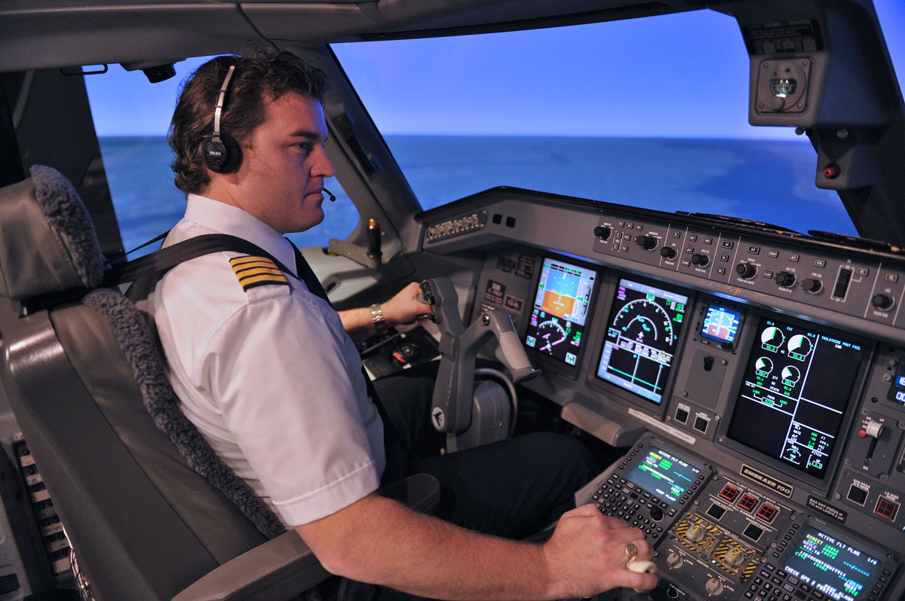
Congratulations !
That’s right.
Snow White’s father is a pilot in the story.

Slide 6
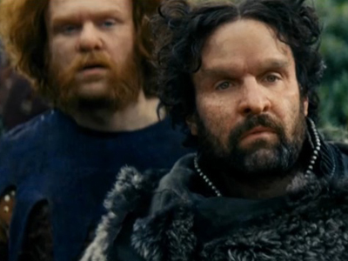
What is the brothers’ job in the story? The brothers are…
The Brothers
a) policemen
b) jewellers
c) bakers

Slide 7
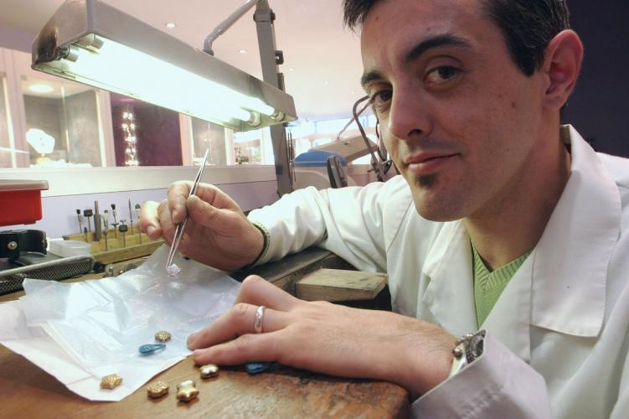
Congratulations !
That’s right.
Hob, Nob and Bob are jewellers in the story. They make jewels

Slide 8
Now, what is your dream job?
What do you want to be when you grow up?
My name’s…
I’m French/English/Turkish/Tunisian/Moroccan…
When I grow up, I want to be…
Notes:
Cherchez dans le dictionnaire en ligne les différents métiers et leur prononciation, formez des binômes pour répéter les phrases

