Slide 1
Snow White and the Seven Dwarfs
Walt Disney

Slide 2
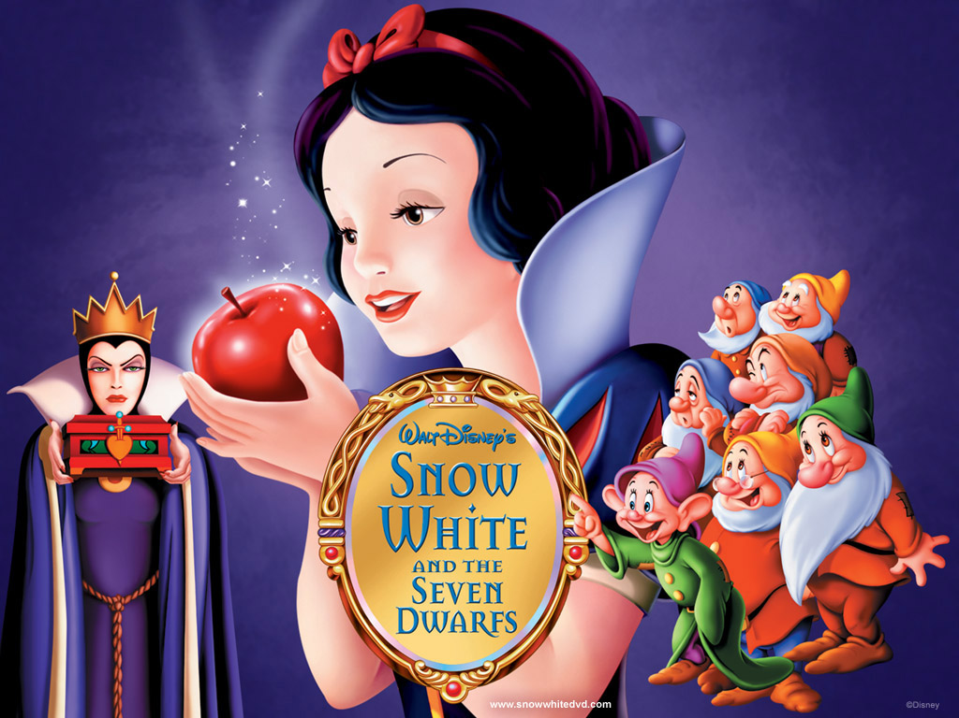

Slide 3
Which words do you know in the title: Snow White and the Seven Dwarfs.
Snow White = Blanche Neige.
Seven Dwarfs ?
Seven = Sept.
But what about « Dwarfs » ?

Slide 4
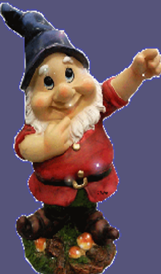
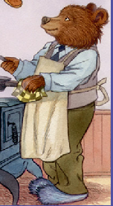
What is a dwarf ?
A)
B)
C)

Slide 5
Is this a dwarf?
This is not a dwarf, this a bear.
Notes:
Question à poser : Is this a dwarf?

Slide 6
Is this a dwarf?
This is not a dwarf. These are apples.

Slide 7
Is this a dwarf?
Yes!
You’re right!
This is a dwarf.

Slide 8
What do Hob, Nob and Bob look like ?
In conclusion a Dwarf in French is: Un nain.
Selon vous à quoi Hob, Nob et Bob ressemblent-ils ?

Slide 9
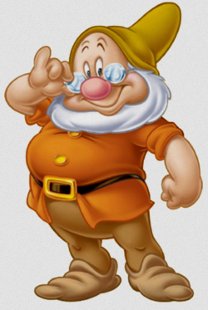
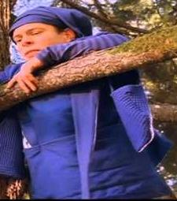
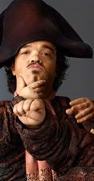
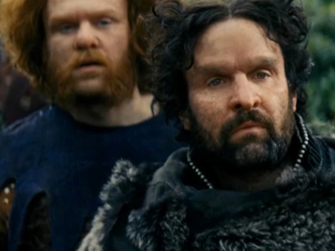
Notes:
Question à poser: Is this Hob, or Bob, or Nob? Perhaps? Let’s look in the book.

