Slide 1
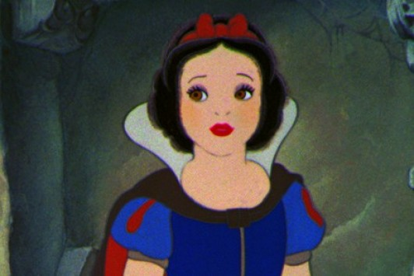
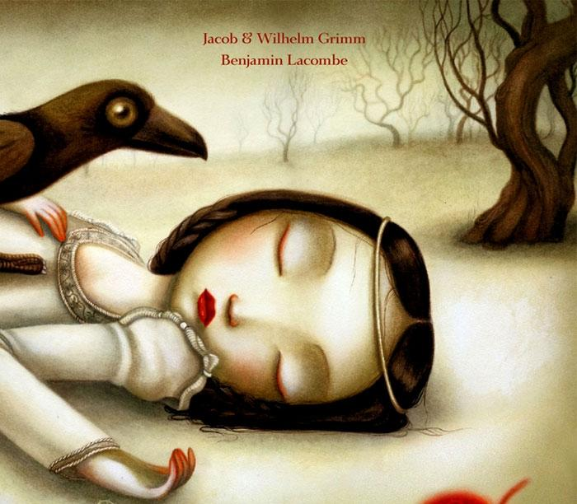
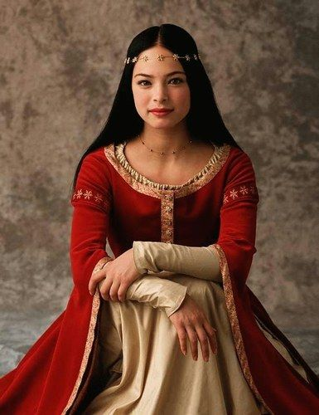
Notes:
Who’s this? It’s a girl. What’s her name? Blanche Neige. What’s her name in English? What’s « blanc » in English? White (vérifiez la prononciation à l’aide d’un dictionnaire en ligne). What’s « neige » in English? Snow (vérifiez la prononciation à l’aide d’un dictionnaire en ligne). Who’s this? This is Snow White.

Slide 2
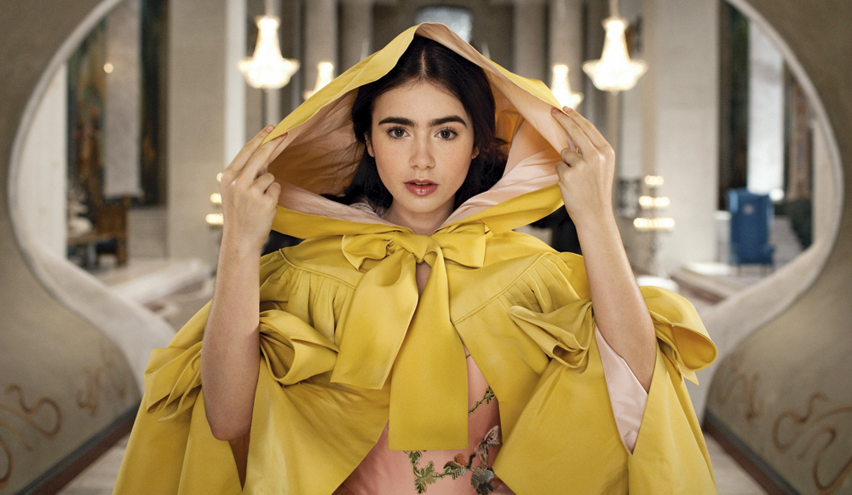
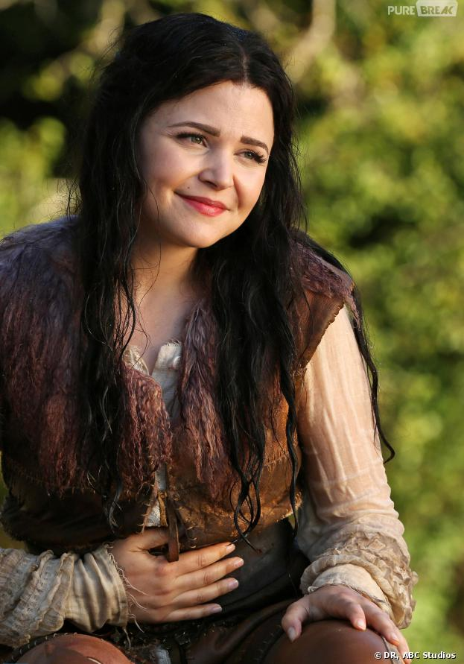
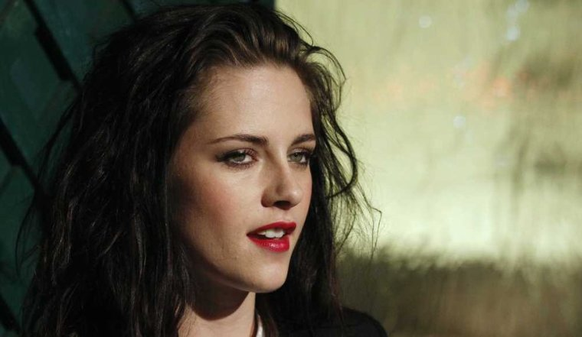
Notes:
Who’s this? This is Snow White.

Slide 3
Can you guess who she is?
« La peau blanche comme la neige, les cheveux noirs comme l’ébène, et les lèvres rouges comme le sang. »
“A child as white as
snow, with lips as red as blood, and hair as black as ebony.”

Slide 4
Show me the parts of the face that correspond to these phrases
As white as snow
As red as blood
As black as ebony

Slide 5
Snow White:
As black as ebony
As red as blood
As white as snow

