Slide 1
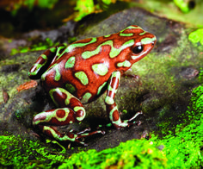
Blanche-Neige et la Magic Frog
« La jeune fille tourna la tête et vit, sur le rebord du bassin, une toute petite grenouille verte et rouge. »

Slide 2
— Frogs are not princes, disait l’un des frères. Frogs are frogs. — Some frogs are not just frogs, dit un autre. Some frogs are princes. — Some frogs are magic frogs, dit le troisième.

Slide 3
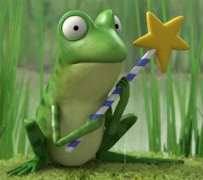
Who do you think is right?
c)A magic frog
a) Just a frog
b) A prince

Slide 4
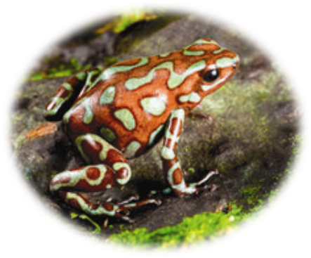
It is true some frogs are just frogs but in this story the frog can speak so it is not just a frog.

Slide 5
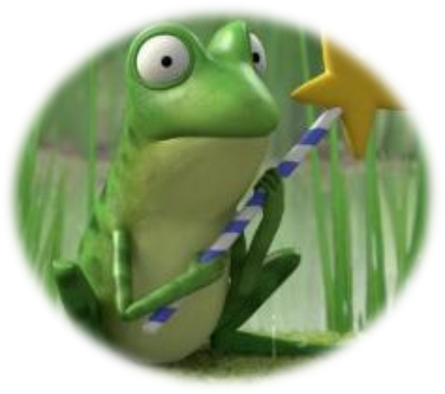
It is true: it is a magic frog
Blanche Neige et la magic frog,
But at the end of this story, we learn that it is not just a magic frog.

Slide 6
Congratulations !
The frog in this story is a prince. At the end of the story:
—That magic frog was a prince, said Hob.
[…]
Snow White was the fairest of them all. And she was a vet. And she married the Prince. And they all lived happily ever after.
What name would you like to give to the prince?
What would you like to call the prince?
Decide what the prince’s name is.

Slide 7
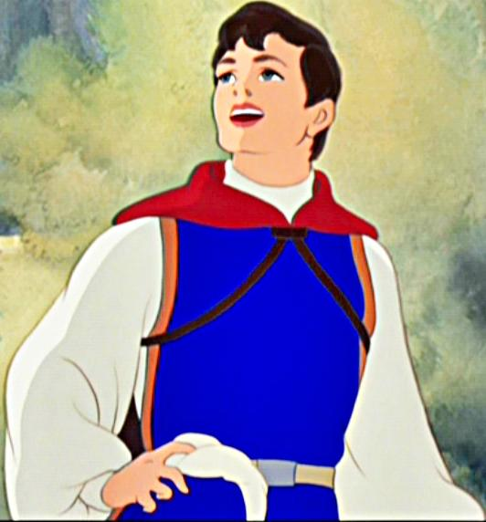
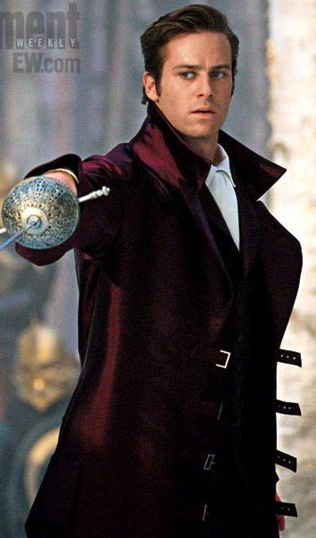
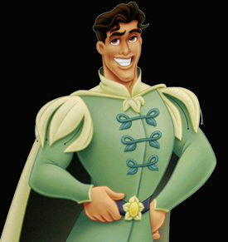
How do you imagine the perfect Prince Charming?

